Slide 1
Data Science Capstone Project Machine Learning
Project :- E – Commerce
By
Raj Singh Rathore
Batch ID – (WS103978)

Slide 2
Overview of the project
An international e-commerce company based in the USA wants to discover key insights from their customer database. They want to use some of the most advanced machine learning techniques to study their customers. The company sells electronic products.
The dataset used for model building contained 10999 observations of 12 variables.
The project is divided into 2 problem statements. Each of the problem is unique.
Used Python programming language to solve the problem statements.

Slide 3
Problem Statements
Problem Statement 1:- What was Customer Rating? And was the product delivered on time?
Problem Statement 2:- Is Customer query is being answered if product importance is high, having highest customer rating or being delivered on time?

Slide 4
Data Description
Variable | Description
ID | ID Number of Customers.
Warehouse block | The Company have big Warehouse which is divided in to block such as A,B,C,D,E.
Mode of shipment | The Company Ships the products in multiple way such as Ship, Flight and Road.
Customer care calls | The number of calls made from enquiry for enquiry of the shipment.
Customer rating | The company has rated from every customer. 1 is the lowest (Worst), 5 is the highest (Best).
Cost of the product | Cost of the Product in US Dollars.
Prior purchases | The Number of Prior Purchase.
Product importance | The company has categorized the product in the various parameter such as low, medium, high.
Gender | Male and Female.
Discount offered | Discount offered on that specific product.
Weight in gms | It is the weight in grams.
Reached on time | It is the target variable, where 1 Indicates that the product has NOT reached on time and 0 indicates it has reached on time.

Slide 5
Data Preparation
The dataset having 10999 observations with 12 variables for building the model.
The ID variable contain the unique number and also corresponded with rows number so it was removed.
The variable names are edited for better understanding.
All the categorical variable converted into numeric variable.
The dataset was checked for missing values. There were no missing values.

Slide 6
Data exploration
The shipments that were not delivered on-time were indicated as 1 and shipments that were delivered on-time is indicated as 0.
The target variable had 6563 shipments didn’t reach on-time and while 4436 shipments that reached on-time.
From that dataset we observed the company had an delayed delivery rate of 59.66 % as compared to on-time delivery rate of 40.33 % .

Slide 7
Data Exploration
Maximum no. of customer in dataset had prior purchase is 3 products. and minimum no. of customer in dataset had prior purchase is 8 products.
Majority of the customer rated as 3 which is received their order on-time.
Majority of products were of low importance.
Most activity from the F block of the warehouse.
A large share of deliveries were done by ships.
Maximum no. of customer in dataset made 4 calls to customer care.

Slide 8
Problem Statement 1:- What was Customer Rating? And was the product delivered on time?

Slide 9
Problem statement 1 and Insights
Customer Ratings Distribution:
2239
2235
2189
2171
2165
Name: rating, dtype: int64
Product Delivery Distribution:
6563
0 4436
Name: on_time, dtype: int64

Slide 10
Problem Statement 2:- • Is Customer query is being answered if product importance is high, having highest customer rating or being delivered on time?

Slide 11
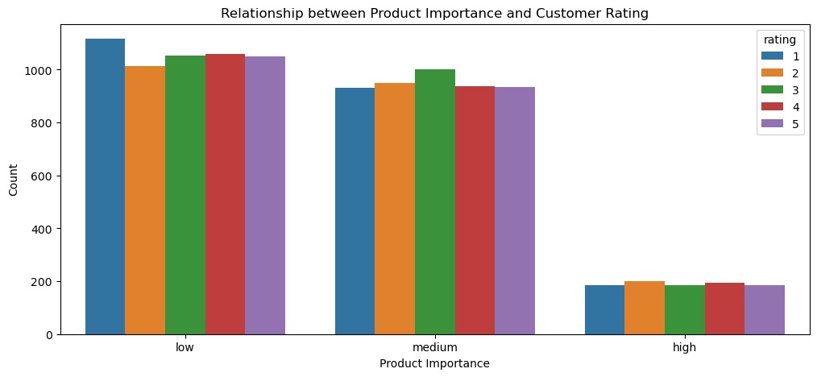
Problem statement 2 and Insights

Slide 12
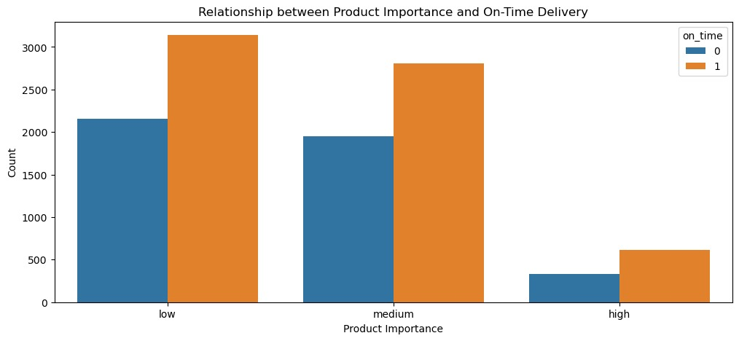
Problem statement 2 and Insights

Slide 13
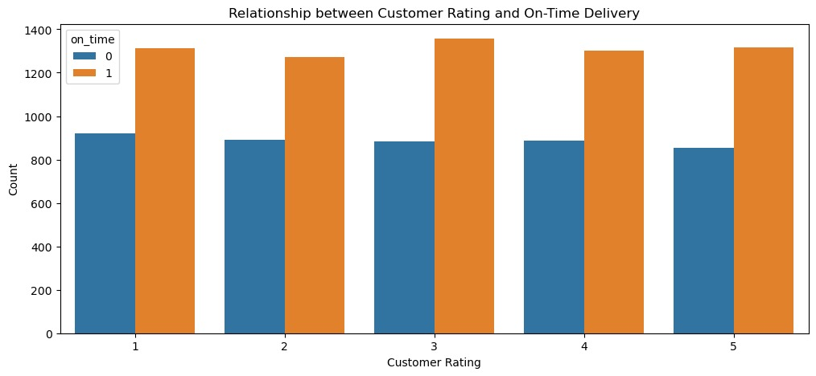
Problem statement 2 and Insights

Slide 14
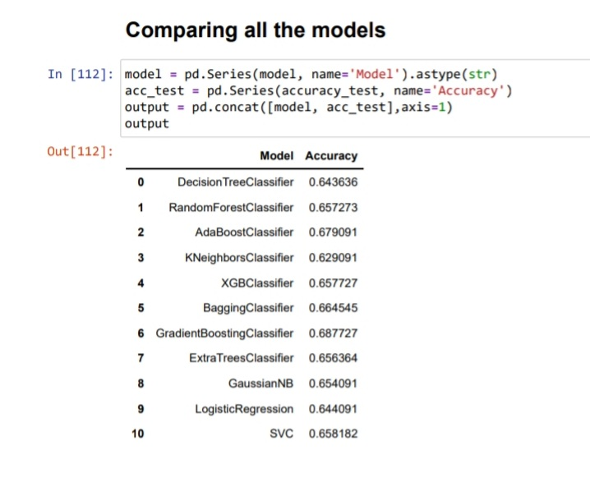
Models Selection Techniques

Slide 15
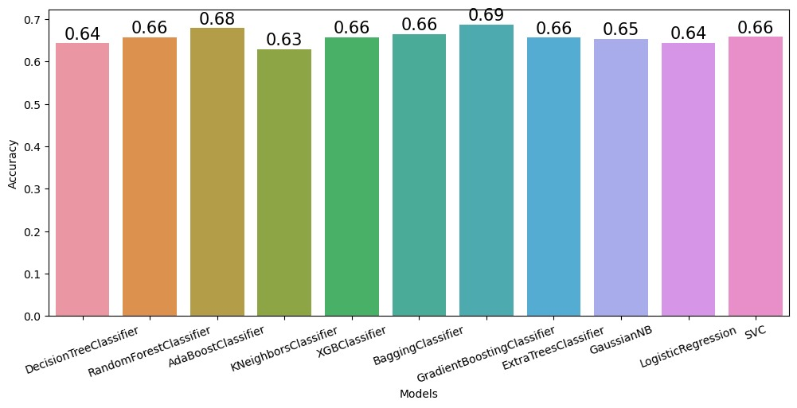
All Models Visualization

Slide 16
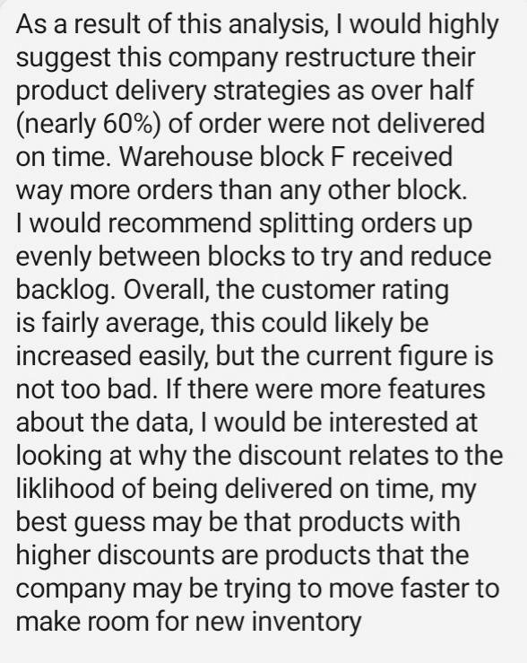
Business Insights and Recommendations

Slide 17
Thank You

